Slide 1
Scout Nights Away and Adventurous Activity Permit Schemes

Slide 2
Meeting!
Will cover:
More activity specific information about Nights Away and Permit activity schemes
More details of how to get permits
Individual action plans
Training available
Lochearnhead 25

Slide 3
Nights Away
POR Rule 9.2
‘The Nights Away Permit Scheme is an internal assessment scheme designed to ensure that all those leading nights away events for young people within Scouts have the skills, experience and personal suitability to do so.’

Slide 5
Categories of Nights Away Permit
Indoor – for staying in a building
Campsite – for staying at a campsite.
Green Field – for staying at any site without facilities.
Lightweight Expedition – for staying at any site for not more
than one night before moving on.
Notes:
Indoor – for staying in a building that has built in lighting and cooking facilities, toilets plumbed into a waste disposal system (i.e., a cess pit, storage tank or mains drains) and running drinking water
Campsite – for staying at a site that has toilets plumbed into a waste disposal system (such as, a cess pit, storage tank or mains drains) and access to running drinking water
Green Field – for staying at any site where any of the above facilities do not exist – for example, a summer camp on a farmer’s field
Lightweight Expedition – for staying at any site for not more than one night before moving on. The core activity is a form of expedition, not residential, and all the equipment is transported with the participants. For example King’s Scout Award or Duke of Edinburgh’s Awards hikes, expedition hikes, canoe expeditions.

Slide 6
Assessment
1. Technical Competence.
This is assessed by the Nights Away Advisers.
2. Scout Association Rules.
This can be assessed by either a NAA or the responsible Lead Volunteer.
3. Safeguarding and Child Protection.
This'll be carried out by the responsible Lead Volunteer.
4. Personal Suitability.
This is carried out by the responsible Lead Volunteer.
Notes:
1. Technical Competence. This is assessed by the Nights Away Advisers (NAA) and looks at the eight core skill areas required to run a nights away event. It's usually assessed through a practical assessment of running an event.
2. Scout Association Rules. This can be assessed by either a NAA or the responsible Commissioner. It looks at whether the Applicant is aware of the Rules and guidance for running nights away events within Scouts.
3. Safeguarding and Child Protection. This'll be carried out by the responsible Commissioner and ensures that the necessary criminal record checks have been carried out and the appropriate safeguarding and child protection training has taken place.
4. Personal Suitability. This is carried out by the responsible Commissioner, often in conjunction with a Group Scout Leader or similar, to check the applicant is suitable (in terms of attitude) to be leading nights away events for young people.

Slide 7
Technical competence
By District Assessor
Greenfield – John Larkin
All categories – Frank Monnington

Slide 8
Nights Away Notification
ALL Nights Away MUST be notified to the District by completion of a Nights Away Notification form (NAN), ideally at least 7 days before the event. Forms can be submitted on-line via the District website
Nights Away Permits are valid for 5 years
More information available on the County and National websites

Slide 9
Adventurous Activity Permit Scheme
Adventurous activities are a key, fun and inspiring part of Scouts.
An adventurous activity permit allows Scouts volunteers to lead that activity for young people within the Scouts.
The adventurous activity permit scheme is a national scheme managed locally.
Each permit can be tailored to the level that your skills, experience and requirements justify.
Notes:
Adventurous activities are a key, fun and inspiring part of Scouts. From a young person getting their first experience of being afloat in a canoe to a trekking expedition through the peaks of Nepal, they provide valuable experiences, lessons and memories for all of those involved. Our role is to ensure the young people get the opportunities for these positive experiences in a safe and fun environment.
An adventurous activity permit allows Scouts volunteers to lead that activity for young people within the Scouts. It shows the young people and their parents that you have the necessary skills and experience to be able to lead these important activities. Details of which activities are classed as adventurous can be found in POR chapter 9. It is designed to be as flexible as possible, while at the same time providing a robust checking process for those leading these activities, but a permit is required to lead that activity.
The adventurous activity permit scheme is a national scheme, managed locally, so that when you have a permit it will allow you to lead the activity for young people from any District or County. Each permit can be tailored to the level that your skills, experience and requirements justify, meaning that restrictions may be placed on such matters as areas, venues or facilities. This ensures that you can lead activities at the right level.

Slide 10
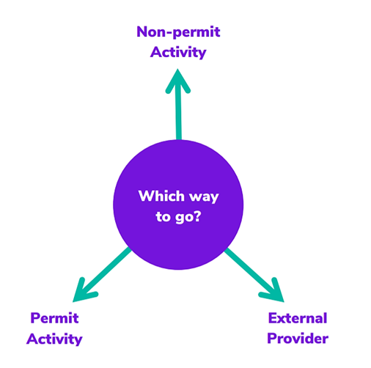

Slide 11
What is a ‘permit’ adventurous activity? POR Rule 97
Includes:
Archery
Climbing & abseiling
Cycling in Terrain 1 & 2
Hovercrafting
All Water Activities (except swimming) on B1, B2 & B3
All motorised activities
A permit holder must be present for any activity with U18 or those with additional needs

Slide 12
Terrains for climbing, abseiling and cycling
Terrain zero
Terrain Zero describes terrain which meets one of criteria (a) or (b):
is below 500 metres above sea level, AND
is within 30 minutes travelling time from a road which can take an ordinary road-going ambulance or a building which is occupied (such as a farm) or another means of summoning help (such as a telephone box) AND
has no steep slopes or rocky terrain, where a slip may result in a fall (Routes or areas where the average person would need to regularly use their hands at least for balance if not for actual progress. This does not stop people from using their hands as an aid to confidence.)
terrain which is a road, or path adjacent to a road, on which you would expect to
see traffic.

Slide 13
Terrains for climbing, abseiling and cycling
Terrain One
Terrain One describes terrain which meets all of criteria (a) and (b) and (c) and (d):
is below 800 metres but more than 500 metres above sea level OR is more than 30 minutes but less than three hours travelling time from a road which can take an ordinary road-going ambulance or a building which is occupied (such as a farm) or another means of calling help (such as a telephone box)
has no steep slopes or rocky terrain, where a slip may result in a fall (routes or areas where the average person would need to regularly use their hands at least for balance if not for actual progress. This does not stop people from using their hands as an aid to confidence.)
is not a road, or path adjacent to a road, on which you would expect to see traffic
is not Terrain Two.

Slide 14
Terrains for climbing, abseiling and cycling
Terrain Two
Terrain Two describes terrain which meets both of criteria (a) and (b):
a. is over 800 metres above sea level,
OR lies more than three hours travelling time from a road which can take an ordinary road-going ambulance or a building which is occupied, such as a farm, or another means of calling help, such as a telephone box
OR has steep slopes or rocky terrain, where a slip may result in a fall including routes or areas where the average person would need to regularly use their hands at least for balance if not for actual progress. This excludes the planned use of ropes, but ropes may be used to give confidence, or in an emergency situation. This also excludes climbing activities
b. is not a road, or path adjacent to a road, on which you would expect to see traffic

Slide 15
Categories of water
Class C | Safe inland waters which are less than 100m wide where flow causes little effect (including swimming pools).
Class B1 | Sheltered inland waters and other sheltered waters where currents and tides create no real danger.
Class B2 | The sea up to one mile from the shore but excluding more dangerous waters close inshore; more sheltered parts of estuaries; large inland lakes and lochs; inland waters Britishr Canoeing Grade 2.
Class B3 | The sea up to three miles from the shore but excluding more dangerous waters close inshore; busy commercial ports, exposed parts of estuaries; inland waters British Canoeing Grade 3.

Slide 16
Permits
Leaders of Scout Permit Activities MUST hold a relevant Permit
Leadership
Supervisory

Slide 17
Leadership Permits
No maximum or minimum age.
For leading the activity for a group of young people while remaining with them.
Doesn't allow remotely supervising an activity or working with multiple groups.
Useful for introducing and training young people in an activity by working directly with them.

Slide 18
Supervisory Permits
No maximum or minimum age.
For remotely supervising an activity for multiple groups.
Doesn't allow approving groups to take part in the activity without remotely supervising them.
Useful for developing young people by giving them opportunities for supervised responsibility.
Can help develop future permit holders by giving them opportunities to deliver activity under supervision

Slide 19
Personal Permits
Maximum age 17, no minimum age
For those taking part in the activity with others who hold personal permits
Doesn't allow leading the activity for anyone without a permit
Useful for allowing young people to progress in an activity by practicing with their peers or to participate in peer-led expeditions

Slide 20
Requirements for a Permit
Technical Competence – This looks at the specific technical skills required to run the activity.
Scout Association Rules – This checks whether the applicant is aware of the activity rules and how they affect the activity within Scouting.
Safety and safeguarding (not for applicants who are under 18) – This will be carried out by the Lead Volunteer or Permit Approver.
Personal Suitability – This is to check the applicant is suitable
Notes:
Technical Competence – This looks at the specific technical skills required to run the activity. It is usually assessed through a practical assessment but other evidence such as logged experience and other qualifications held can help as well. There is an assessment checklist for each activity listing the skills that will be assessed. (By the Assessor)
Scout Association Rules – This checks whether the applicant is aware of the activity rules and how they affect the activity within Scouting. (By your Commissioner / Lead Volunteer, Permit Approver or County Assessor)
Safety and safeguarding (not for applicants who are under 18) – This will be carried out by the Commissioner / Lead Volunteer or Permit Approver or their nominee and ensures that the necessary personal enquiry checks have been carried out and the appropriate safety and safeguarding mandatory learning has taken place. (By your Commissioner / Lead Volunteer, Permit Approver)
Personal Suitability – This is to check the applicant is suitable (in terms of attitude, health for the activity involved etc.) to be leading an adventurous activity for young people. This may require the permit approver to seek input from others who know or operate with the applicant. (By your Commissioner / Lead Volunteer, Permit Approver )

Slide 21
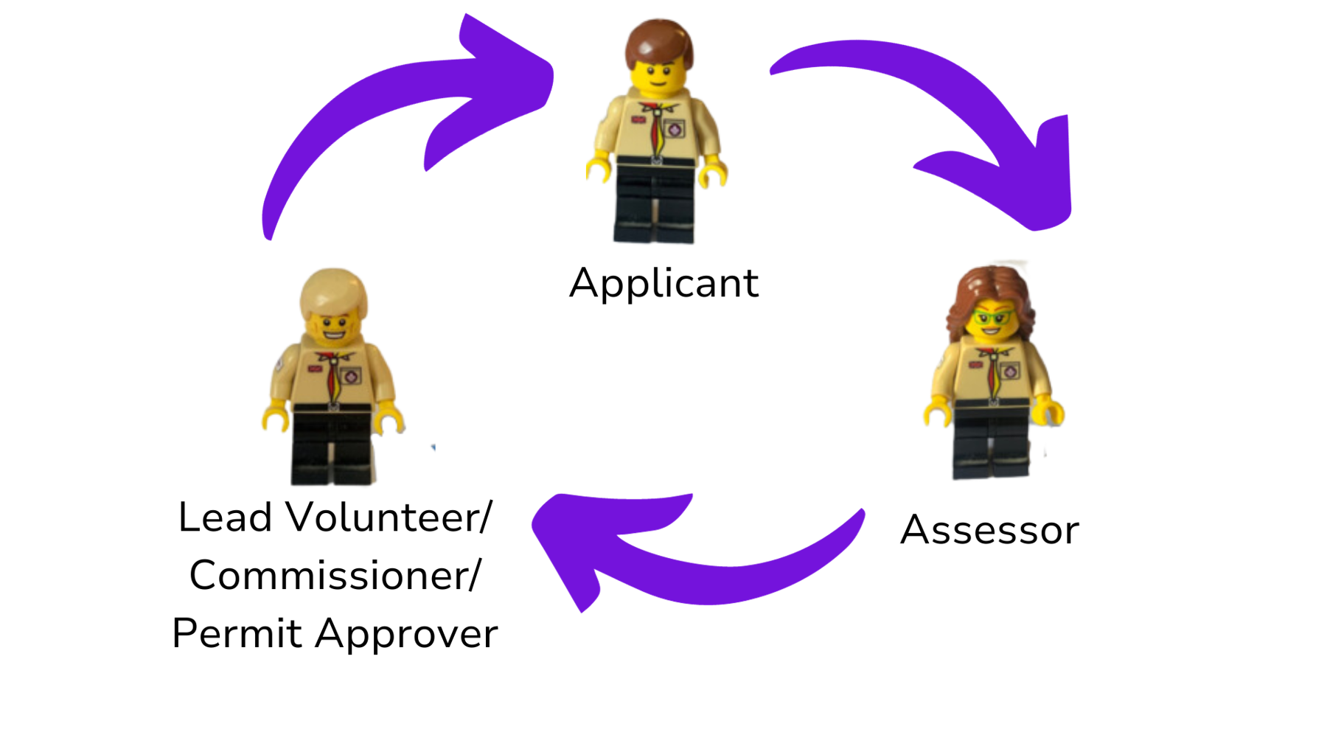
How it works
How the scheme works
How the scheme works

Slide 22
Technical competence
Shown by:
National Governing Body Awards e.g. Mountain Training, British Canoeing, RYA
or by
An assessment by an assessor approved by Scouts
Notes:
Practical assessment - Putting the applicant in the activity environment and assessing whether they have the skills.
Theoretical assessment -Talking with the applicant, often through scenarios and examples, to find out how they would deal with them.
Logged experience - Looking at the breadth, circumstances and currency of the applicant’s experience. Experience gained as a young person should also be taken into account.
Relevant qualifications - Where applicants have already been assessed for other qualifications, whether through other organisations such as Girlguiding, from national governing bodies, or previous permits within the Scouts, then this can be used to show competence in certain areas of the assessment checklist.
A County Assessor may also assess the applicant’s knowledge of the relevant Scouts activities rules and how these will affect them and the activity, and record this on the assessment checklist.

Slide 23
Permit Activity Action Plan
Name
Preferred contact
Group
Position (e.g. Lead volunteer, Team Member)
Permit activities interested in
Previous experience
Current qualifications
Objectives
Training needed
Time frame
Action plan

Slide 24
www.hemel-scouts.co.uk
www.hertfordshirescouts.org.uk
www.scouts.org.uk
colin@hemel-scouts.co.uk

